Slide 1

Machine Learning with Python
Session 12: Cluster Analysis
Arghya Ray

Slide 2
Rational for Measuring Cluster Goodness
What are the optimal number of cluster to identify?
How do I measure weather one set of clusters is preferable to another?
The silhouette method and the pseudo-F statistic will help us address these questions by measuring cluster goodness.
Concepts Measures Should Address
Cluster separation represents how distant the clusters are from each other
Cluster cohesion refers to how tightly related the records within the individual clusters are
Good measures should incorporate both as do the silhouette and pseudo-F statistic
However, the sum of squares error (SSE) only accounts for cluster cohesion and is monotonically decreasing with increasing numbers of clusters.

Slide 3
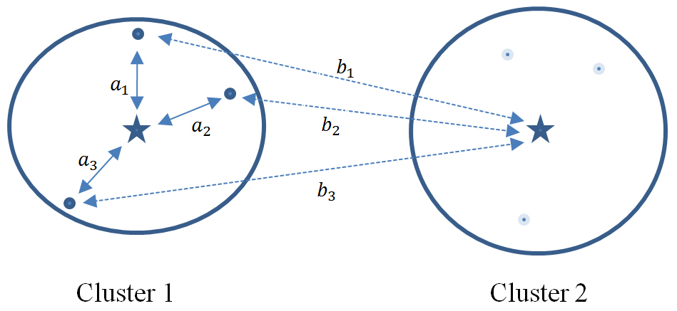
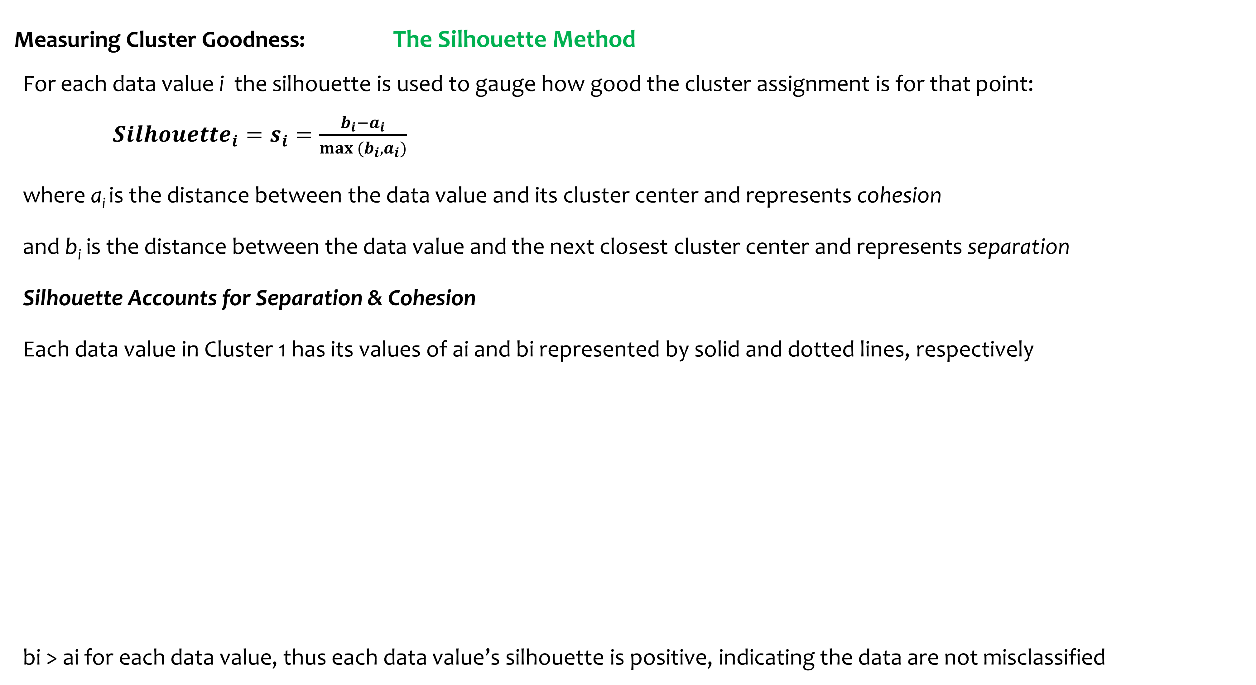
Measuring Cluster Goodness: The Silhouette Method
For each data value i the silhouette is used to gauge how good the cluster assignment is for that point:
${Silhouette}_{i}=s_{i}=\frac{b_{i}−a_{i}}{max (b_{i}, a_{i})}$
where a_{i} is the distance between the data value and its cluster center and represents cohesion
and b_{i} is the distance between the data value and the next closest cluster center and represents separation
Silhouette Accounts for Separation & Cohesion
Each data value in Cluster 1 has its values of ai and bi represented by solid and dotted lines, respectively
bi > ai for each data value, thus each data value’s silhouette is positive, indicating the data are not misclassified

Slide 4
Measuring Cluster Goodness: The Silhouette Method contd…
A positive value indicates that the assignment is good, with higher values better than lower values.
A value close to zero is considered to be weak since the observation could have been assigned to the next cluster with little negative consequence.
A negative value is considered to be misclassified since assignment to the next closest cluster would have been better.
The Average Silhouette Value
The average silhouette value over all records yields a measure of how well the cluster solution fits. A thumbnail interpretation, meant as a guide only:
0.5 or better provides good evidence of the reality of the clusters in the data
0.25 – 0.5 provides some evidence of the reality of the clusters in the data.
Less than 0.25 provides scant evidence of cluster reality

Slide 5
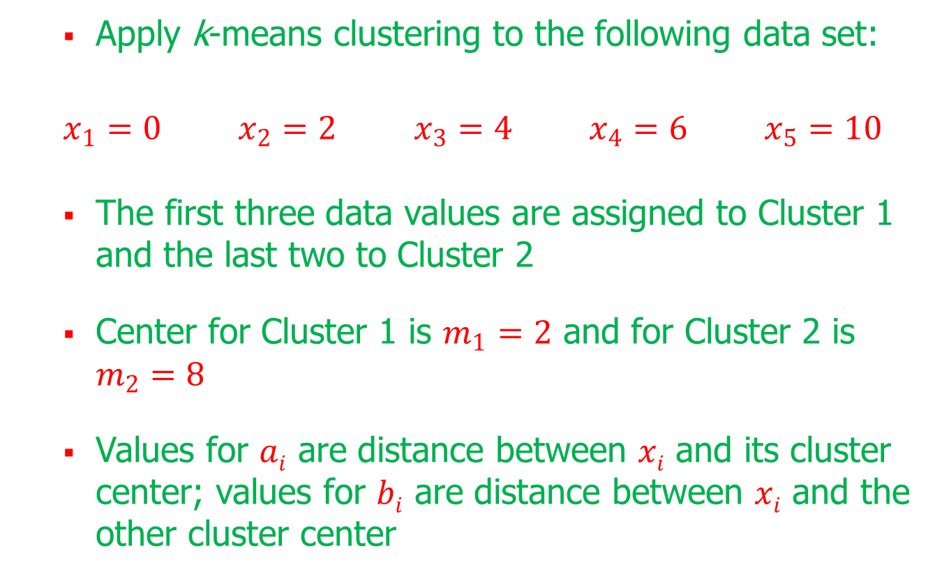
Silhouette Example (cont.)
Apply k-means clustering to the following data set:
$x_{1}=0$ $x_{2}=2$ $x_{3}=4$ $x_{4}=6$ $x_{5}=10$
The first three data values are assigned to Cluster 1 and the last two to Cluster 2
Center for Cluster 1 is $m_{1}=2$ and for Cluster 2 is $m_{2}=8$
Values for $ai$ are distance between $xi$ and its cluster center; values for $bi$ are distance between $xi$ and the other cluster center

Slide 6
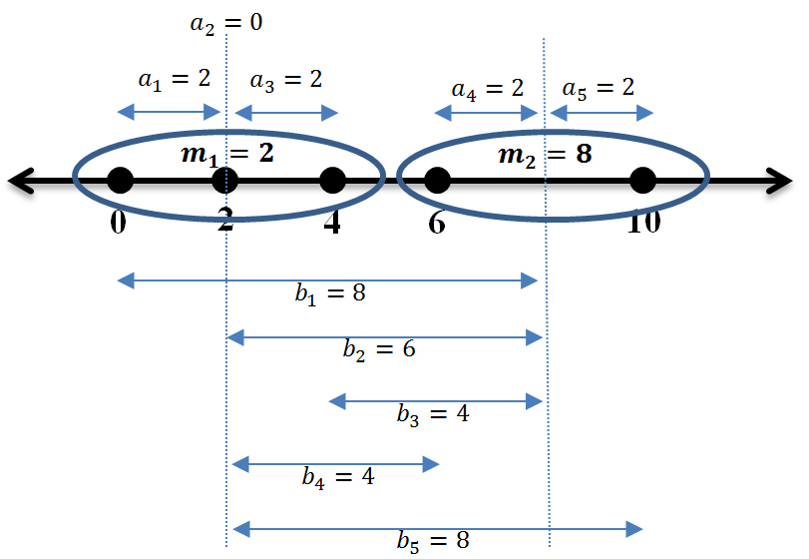
Silhouette Example (cont.)
Distances between the data values and cluster centers:

Slide 7
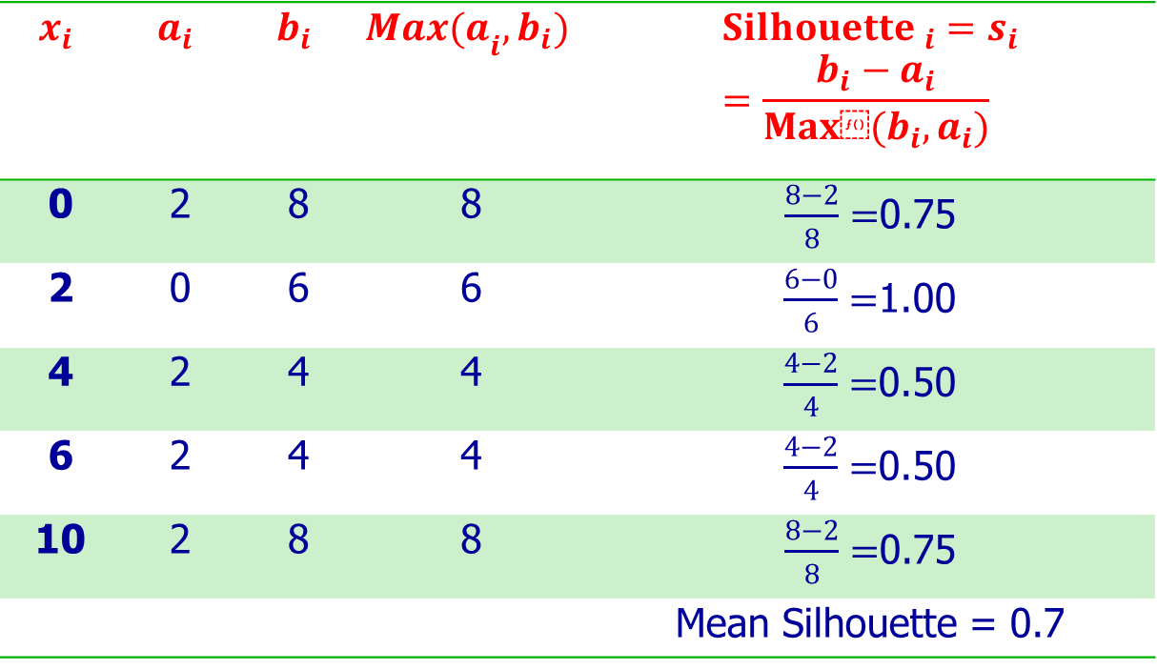
Silhouette Example (cont.)
Calculations for individual data values:
$$x_{i}$$ | $$a_{i}$$ | $$b_{i}$$ | $${Max(a}_{i},b_{i})$$ | $${Silhouette }_{i}=s_{i}=\frac{b_{i}−a_{i}}{Max⁡(b_{i}, a_{i})}$$
0 | 2 | 8 | 8 | $\frac{8−2}{8}=$0.75
2 | 0 | 6 | 6 | $\frac{6−0}{6}=$1.00
4 | 2 | 4 | 4 | $\frac{4−2}{4}=$0.50
6 | 2 | 4 | 4 | $\frac{4−2}{4}=$0.50
10 | 2 | 8 | 8 | $\frac{8−2}{8}=$0.75
 |  |  |  | Mean Silhouette = 0.7

Slide 8
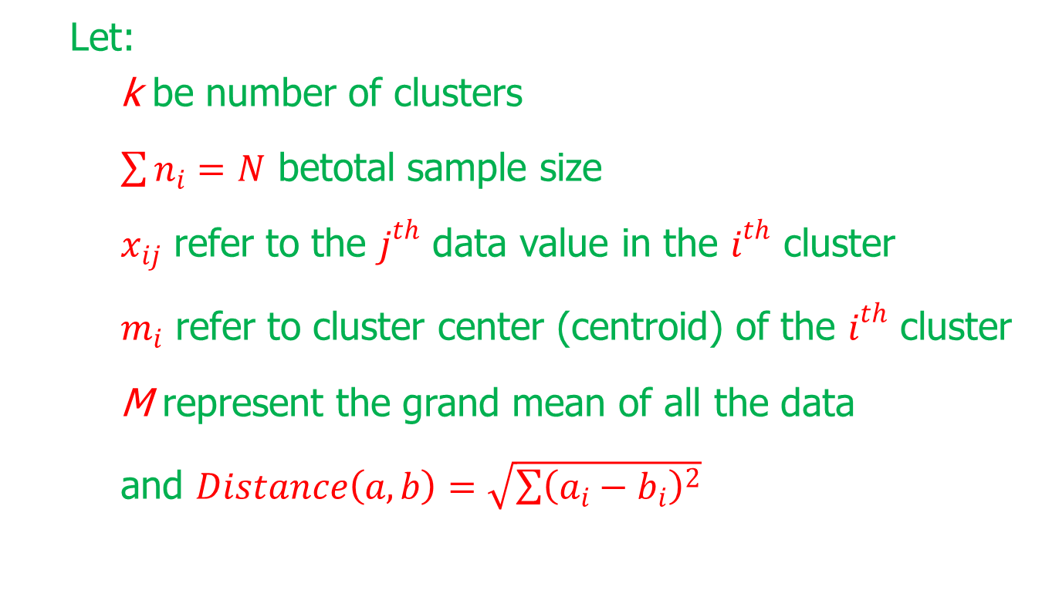
The pseudo-F Statistic
Let:
k be number of clusters
$\sum{n_{i}=N}$ betotal sample size
$x_{ij}$ refer to the $j^{th}$ data value in the $i^{th}$ cluster
$m_{i}$ refer to cluster center (centroid) of the $i^{th}$ cluster
M represent the grand mean of all the data
and $Distance\left(a,b\right)=\sqrt{\sum{{\left(a_{i}−b_{i}\right)}^{2}}}$

Slide 9
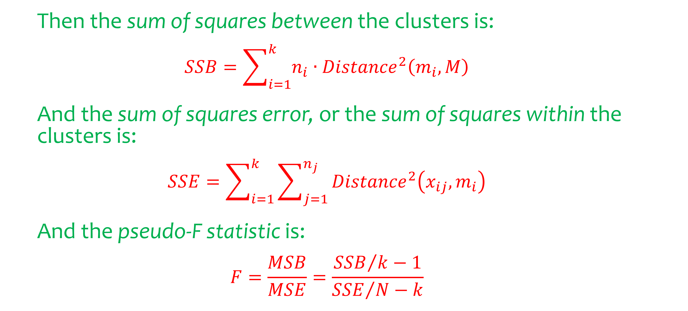
The pseudo-F Statistic (cont.)
Then the sum of squares between the clusters is:
$$SSB=\sum_{i=1}^{k}{n_{i}∙{Distance}^{2}\left(m_{i}, M\right)}$$
And the sum of squares error, or the sum of squares within the clusters is:
$$SSE=\sum_{i=1}^{k}{\sum_{j=1}^{n_{j}}{{Distance}^{2}\left(x_{ij},m_{i}\right)}}$$
And the pseudo-F statistic is:
$$F=\frac{MSB}{MSE}=\frac{{SSB}/{k−1}}{{SSE}/{N−k}}$$

Slide 10
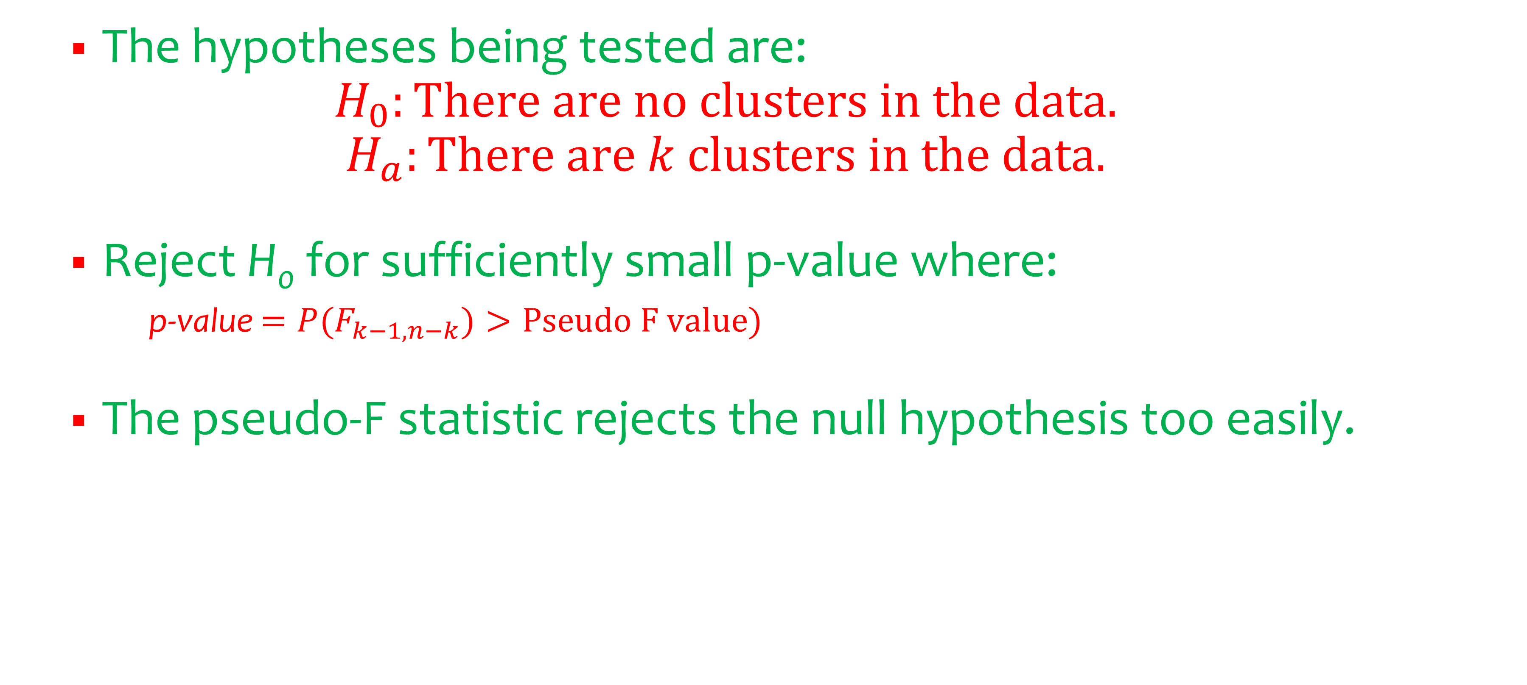
The pseudo-F Statistic (cont.)
The hypotheses being tested are:
$$H_{0}:There are no clusters in the data.$$
$$H_{a}:There are k clusters in the data.$$
Reject H₀ for sufficiently small p-value where:
p-value $=P(F_{k−1,n−k})>Pseudo F value)$
The pseudo-F statistic rejects the null hypothesis too easily.

Slide 11
The pseudo-F Statistic (cont.)
The pseudo-F statistic should not be used to determine the presence of clusters but can be used to select the optimal number of clusters as follows:
Use a clustering algorithm to develop a clustering solution for a variety of values of k.
Calculate the pseudo-F statistic and p-value for each candidate, and select the candidate with the smallest p-value as the best clustering solution.

Slide 12
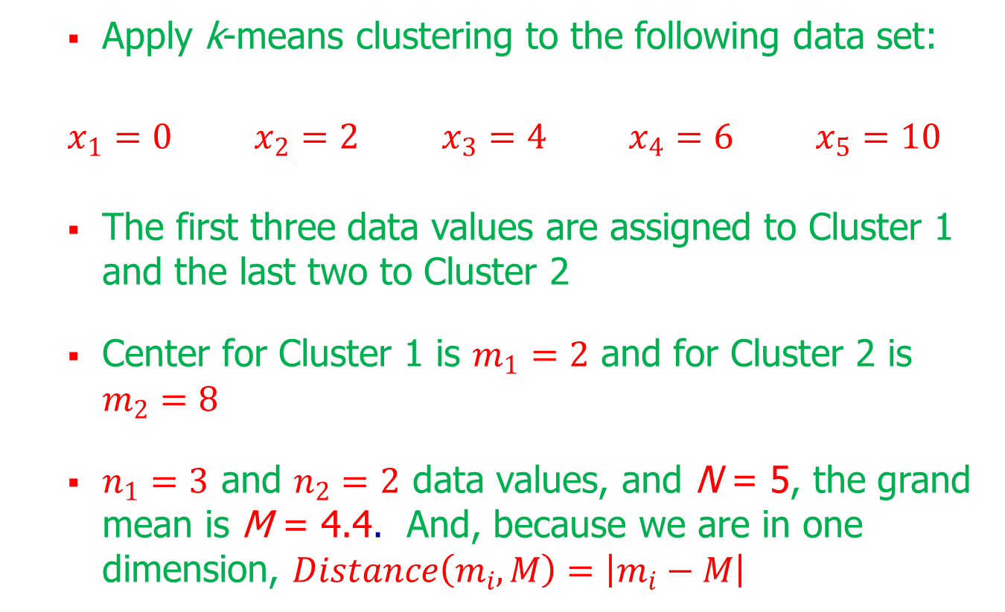
Pseudo-F Statistic Example
Apply k-means clustering to the following data set:
$x_{1}=0$ $x_{2}=2$ $x_{3}=4$ $x_{4}=6$ $x_{5}=10$
The first three data values are assigned to Cluster 1 and the last two to Cluster 2
Center for Cluster 1 is $m_{1}=2$ and for Cluster 2 is $m_{2}=8$
$n_{1}=3$ and $n_{2}=2$ data values, and N = 5, the grand mean is M = 4.4. And, because we are in one dimension, $Distance\left(m_{i}, M\right)=\left|m_{i}−M\right|$

Slide 13
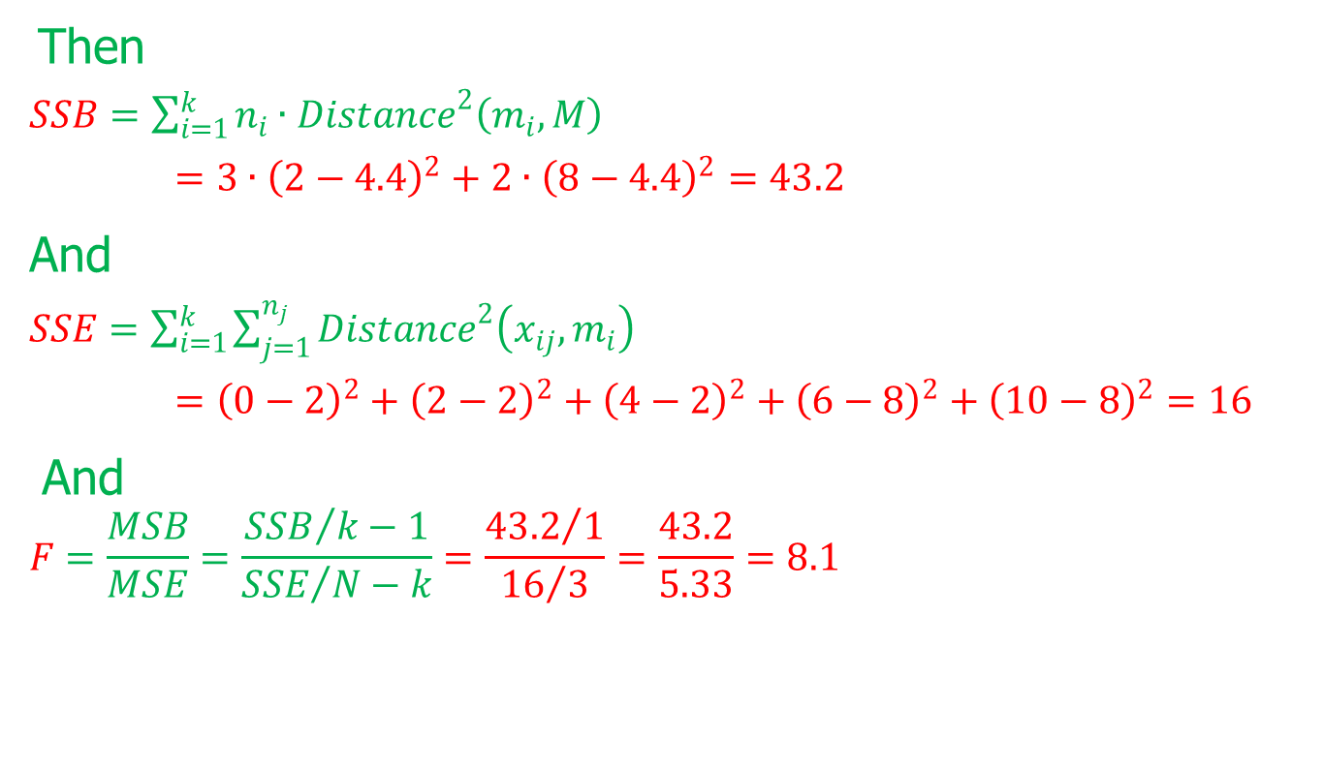
Pseudo-F Statistic Example (cont.)
Then
$SSB=\sum_{i=1}^{k}{n_{i}∙{Distance}^{2}\left(m_{i}, M\right)}$
$=3∙{\left(2−4.4\right)}^{2}+2∙{\left(8−4.4\right)}^{2}=43.2$
And
$SSE=\sum_{i=1}^{k}{\sum_{j=1}^{n_{j}}{{Distance}^{2}\left(x_{ij},m_{i}\right)}}$
$={\left(0−2\right)}^{2}+{\left(2−2\right)}^{2}+{\left(4−2\right)}^{2}+{\left(6−8\right)}^{2}+{\left(10−8\right)}^{2}=16$
And
$$F=\frac{MSB}{MSE}=\frac{{SSB}/{k−1}}{{SSE}/{N−k}}=\frac{{43.2}/1}{{16}/3}=\frac{43.2}{5.33}=8.1$$

Slide 14
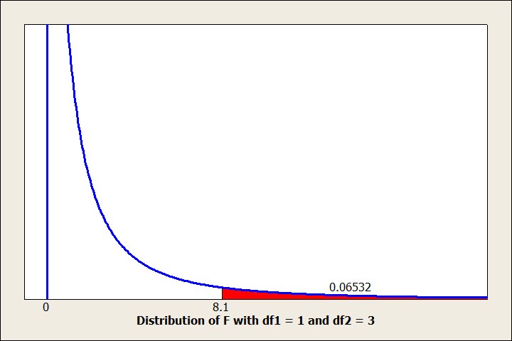
Pseudo-F Statistic Example (cont.)
Distribution of the F statistic shows that p-value of 0.06532 does not indicate strong evidence of clusters:
Notes:
=FDIST(8.1,1,3)

Slide 15
Cluster Validation
As with any other data mining modeling technique, cluster analysis should be subject to cross-validation to ensure the clusters are real
A simple graphical and statistical approach with the goal of confirming the clusters found in the test data match those in the training data is:
Apply cluster analysis to training data
Apply cluster analysis to test data
Use graphics and statistics to confirm the clusters in the training data match those in the test data

Slide 16
The content of the slides are prepared from different textbooks.
References:
Data Mining and Predictive Analytics, By Daniel T. Larose. Copyright 2015 John Wiley & Sons, Inc.
Predictive Analytics for Dummies, By Anasse Bari, Mohamed Chaouchi, & Tommy Jung, Copyright 2016, John Wiley & Sons, Inc.
Introduction to Data Mining with Case Studies, By G.K. Gupta. Copyright 2014 by PHI Learning Private Limited.

Slide 17

Thank you..

